Slide 1
Legal Lens
Decode the law , Demand your rights !

Slide 2
Table of contents
01
02
03
04
Problem Statement
Our Solution
What’s Different
Out Team

Slide 3

01
Problem Statement
Why do we need Legal Lens?

Slide 4
The Legal World is Stuck in the Past
Legal professionals and citizens in India struggle with time-consuming legal research, scattered information, and poor access to affordable legal help. Legal Lens solves this with an AI-powered platform for smart legal insights, case law search, and contract analysis — fast, reliable, and made for India.

Slide 5
Legal Lens Strategies to Solve Key Legal Challenges:
AI-Powered Legal Research
Accessible Legal Guidance for All
Smart Contract & Document Analysis
Instantly fetches relevant case laws, statutes, and legal interpretations using NLP and ML tailored for Indian law.
Provides simplified legal insights and Q&A support for individuals unfamiliar with legal terms, improving legal awareness and accessibility.
Scans legal documents to detect risks, clauses, and summaries — saving hours of manual review for lawyers and businesses.

Slide 6
What’s Different?

Slide 7
Answers and supporting arguments
How can Legal Lens revolutionize legal access and research in India?
Solve core legal system challenges using AI-driven technology
Automate Legal Research to Save Time and Improve Accuracy
Democratize Legal Knowledge and Guidance
Analyze Legal Documents with AI to Save Lawyer Hours
Use NLP to interpret user queries in natural language
Provide easy-to-understand legal insights for the general public
Scan contracts and highlight critical clauses, risks, and summaries
Fetch relevant case laws, statutes & legal interpretations instantly
Break down complex legal jargon into simple language
Use AI to flag potential legal loopholes or compliance issues
Learn from user behavior to improve search relevance
Create an accessible legal Q&A assistant for everyday problems
Support small firms and startups in legal documentation

Slide 8

81,402
Male farmers suicide in India between 2015-22
11628 per year due to legal issues

Slide 9
5 Crore
13+ Years
Over 80%
Less than 5%
Cases Pending in Indian Courts (As of 2024)
Average Time to Resolve a Civil Case
lack access to qualified legal aid — leaving millions vulnerable and uninformed.
of Indians Are Legally Literate

Slide 10
Our Team
01
02
03
04
Abhinav Singh
Raghav Garg
Yousuf Wizdan
Prasoon Dwivedi
05
Yash
Bhardwaj

Slide 11
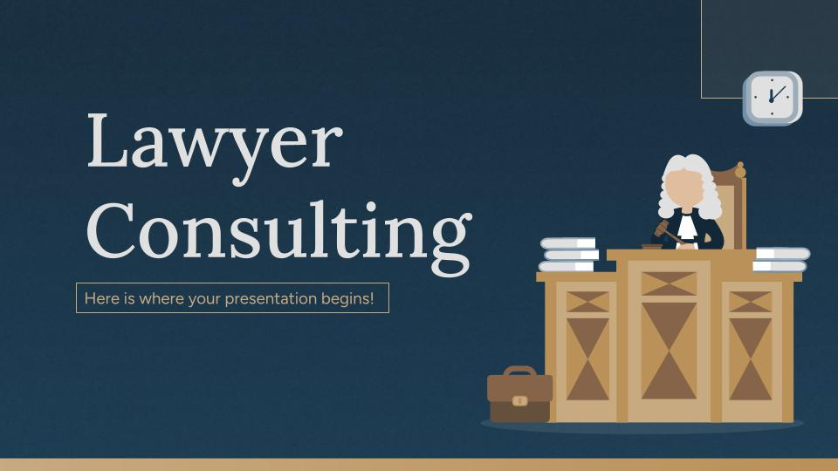
A Glimpse to new India
You can replace the image on the screen with your own work. Just right-click on it and select “replace image”

Slide 12
Thanks!
Any questions?
Legallens.help@gmail.com
Please keep this slide for attribution

Slide 13
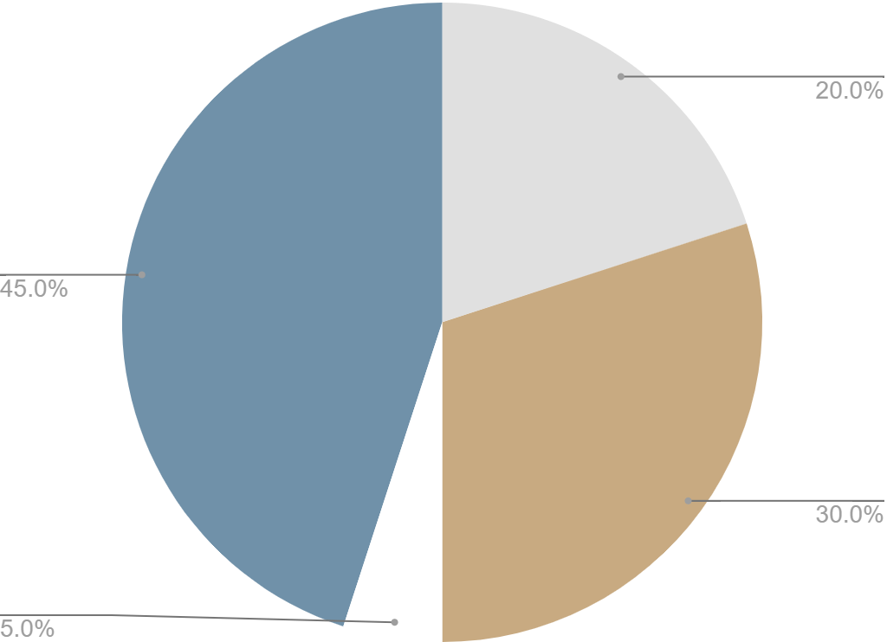
Impact of the risks
45%
20%
Lawyers and students often struggle to find relevant case laws and interpretations efficiently.
Many citizens are unaware of their legal rights and procedures due to low legal literacy.
Difficulty in Legal Research & Access to Case Law
Lack of Legal Awareness
5%
30%
High legal fees make it difficult for individuals and small businesses to afford proper representation.
Massive backlog — over 4 crore cases pending across Indian courts. Delays affect justice delivery.
Costly Legal Services
Delayed Case Resolutions

